Slide 1
Password Management
Overview

Slide 2
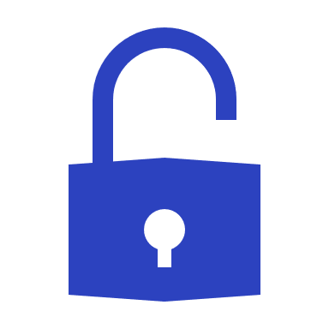
Why Password Management Is So Important for SMBs
78% of attackers use stolen passwords to gain access to business applications¹
65% of end users are using IDENTICAL passwords for multiple accounts²
43% of cyberattacks target small businesses³
1. “Verizon’s 2020 Data Breach Investigations Report,” Verizon. https://enterprise.verizon.com/resources/reports/dbir/ (Accessed April 2021).
2. “Online Security Survey,” Google/Harris Poll. https://services.google.com/fh/files/blogs/google_security_infographic.pdf (Accessed April 2021).
3. “Cyberattacks now cost companies $200,000 on average, putting many out of business,” CNBC. https://www.cnbc.com/2019/10/13/cyberattacks-cost-small-companies-200k-putting-many-out-of-business.html (Accessed April 2021).

Slide 3
What You Need to Know
Threats to Your Password Security
Brute force attacks
Phishing
Spoof websites
Business Benefits of Our Password Management Solution
Better time management: No looking for passwords
Fewer IT support requests: Lower password resets
Higher efficiency: Passwords available across devices and platforms
Complete transparency: Know who, what, when, and where
Granular, top-level administrative control, management, and reporting: Automatically push out company password policy across your employee base

Slide 4
What is Happening in Cybersecurity?
How confident are you that your employees are not using the same password for different accounts?
Do you monitor who is using sensitive data and when?
What is the risk of former employees retaining passwords?
of employees admit to retaining access to at least one application from a former employer*
89%
admit to logging into and using an account from their former employer*
Your passwords are the keys to your entire organization, workflow, and confidential client data. They have to be protected.
49%
*“Intermedia: 89% of Former Employees Can Still Access Corporate Apps,” Channel Futures. https://www.channelfutures.com/business-models/intermedia-89-of-former-employees-can-still-access-corporate-apps (Published August 2014, Accessed April 2020).

Slide 5
Installing a Culture of Security
Password Management Best Practices
Create complex passwords Eliminate weak passwords or password reuse
Design strong access policies Assign role-based access and lock out former employees
Protect business applications Adjust permissions as employees advance or leave
Anytime, anywhere access Sync credentials across devices and platforms—on-site, mobile, and cloud
Reporting for compliance Meet data privacy and financial regulations
Run audits and reports Monitor and audit who is accessing sensitive data and when
Prevent cybercriminal access to your network

Slide 6
What’s Wrong with “Free” or Consumer-Grade Password Management Tools?
Most free and consumer-grade solutions don’t:
Offer one controllable password service shared across your organization
Mitigate passwords walking out the door with former employees
Give you a centralized way to limit or revoke access
Enable comprehensive usage tracking, auditing, and reporting
Use an encrypted password zero-trust protocol for sharing passwords with us to expedite support tasks
When your business is at stake, why trust anything but enterprise password management with military-grade encryption?

Slide 7
Why Implement A Password Management Solution?
It’s simple to learn and use
Helps staff automatically follow password best practices
Assists you in demonstrating compliance
Let’s you control who has access to what systems
Makes it easy to terminate access to departing employees
Makes it easier to onboard new employees
How do we know this? It’s what we use and recommend!

Slide 8
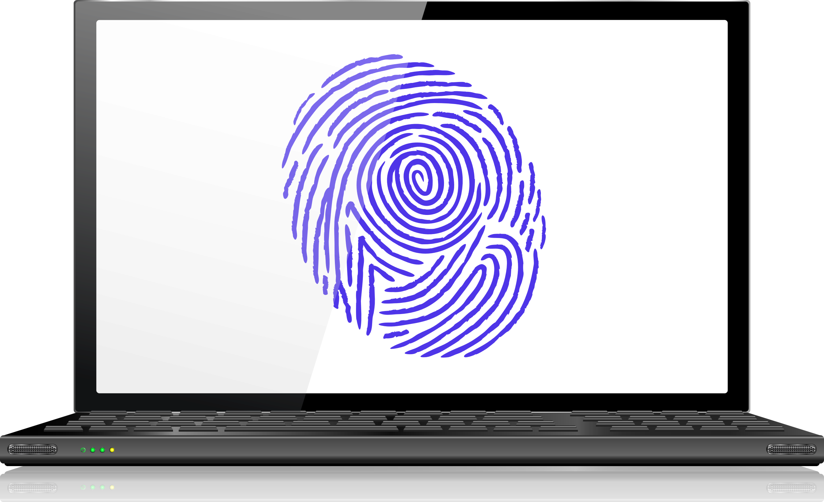
In Conclusion
Security: Don’t risk simple password selection
Ease and efficiency: No need to remember passwords with one-click logins
Access control: Manage employee system access
Onboarding/offboarding: Lock out former employees
Auditing for compliance: Always know what happened

Slide 9
What’s Next?
Visit https://nettechconsultants.com/ to learn more
Email to: sales@nettechconsultants.com
Call us: (904) 992-6970

